Slide 1
ONLINE SHOPPING
SHOP CART
By
Pradhipha M
Priyadharsini T
Manimegalai P
Sivasangari R

Slide 2
INTRODUCTION
The basic concept of the application is to allow the customer to shop virtually using the Internet and allow customers to buy the items and articles of their desire from the store.

Slide 3
MODULES
REGISTRATION
LOGIN
USER
ADMIN
RETAILER

Slide 4
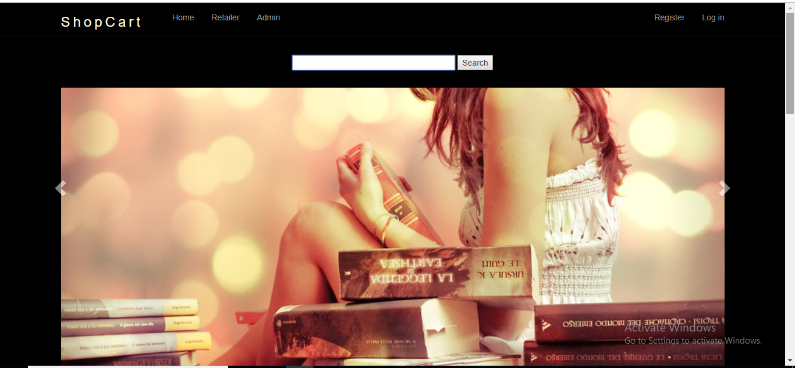
HOME PAGE

Slide 5
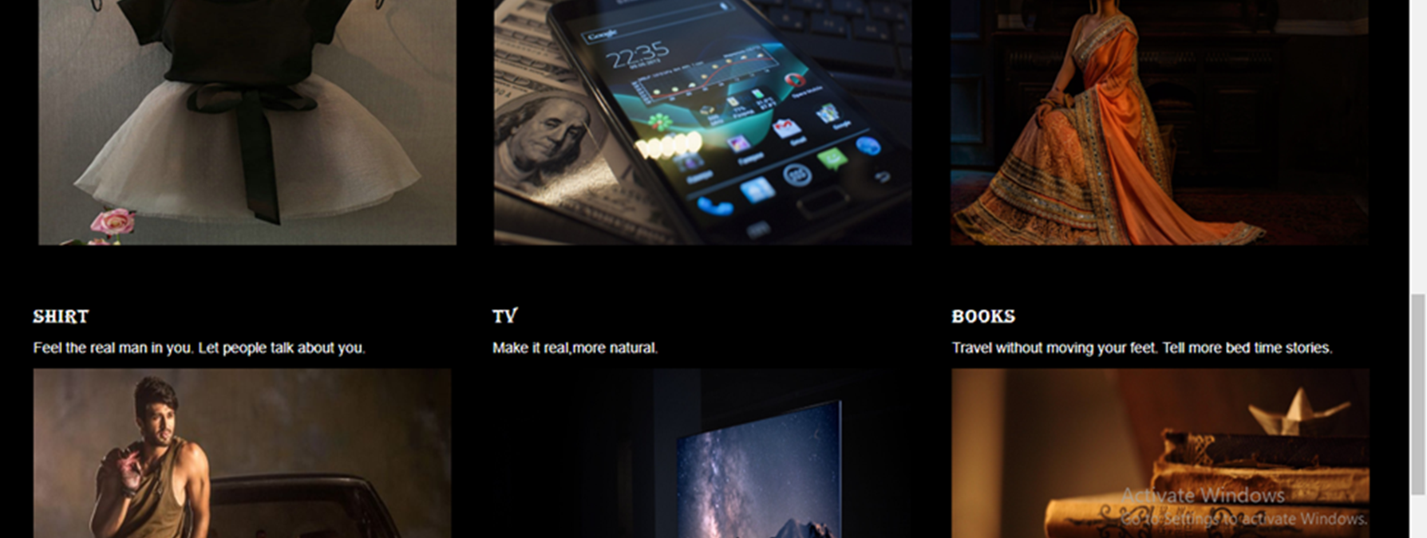

Slide 6
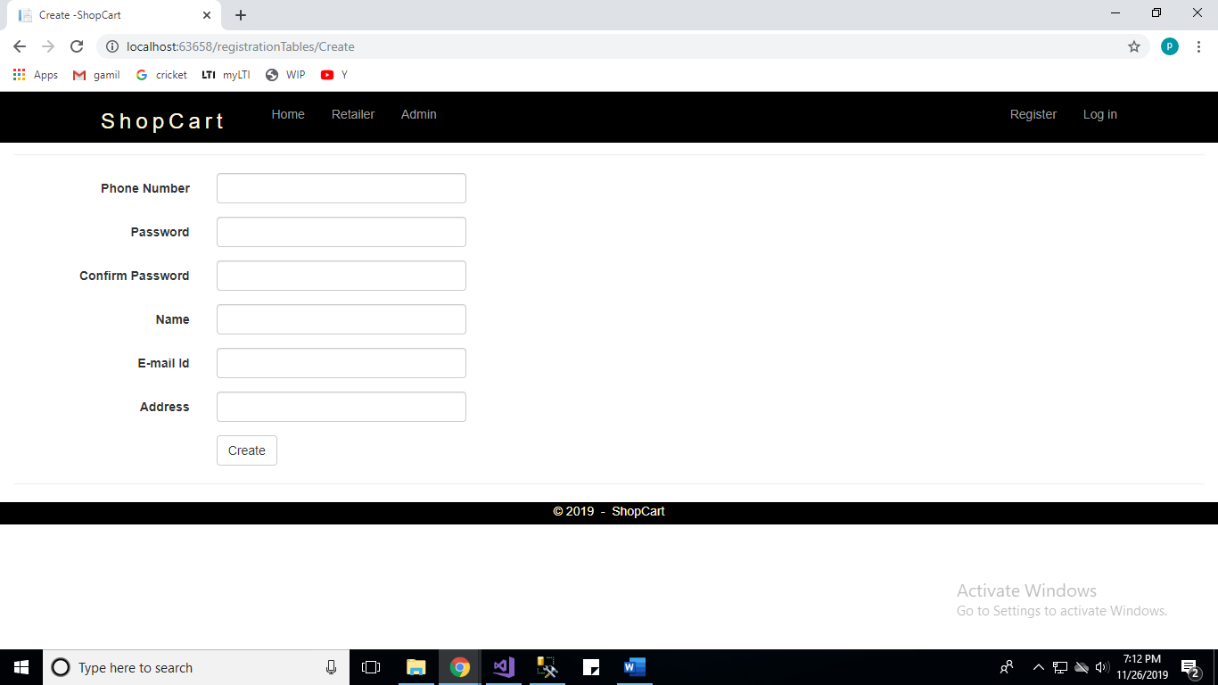
REGISTRATION

Slide 7
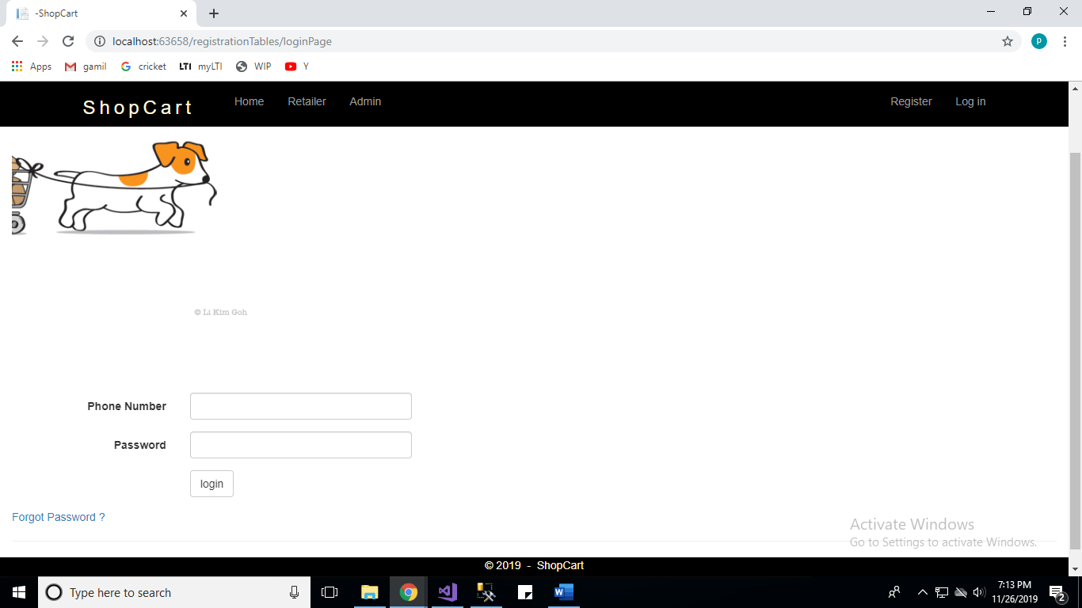
LOGIN

Slide 8
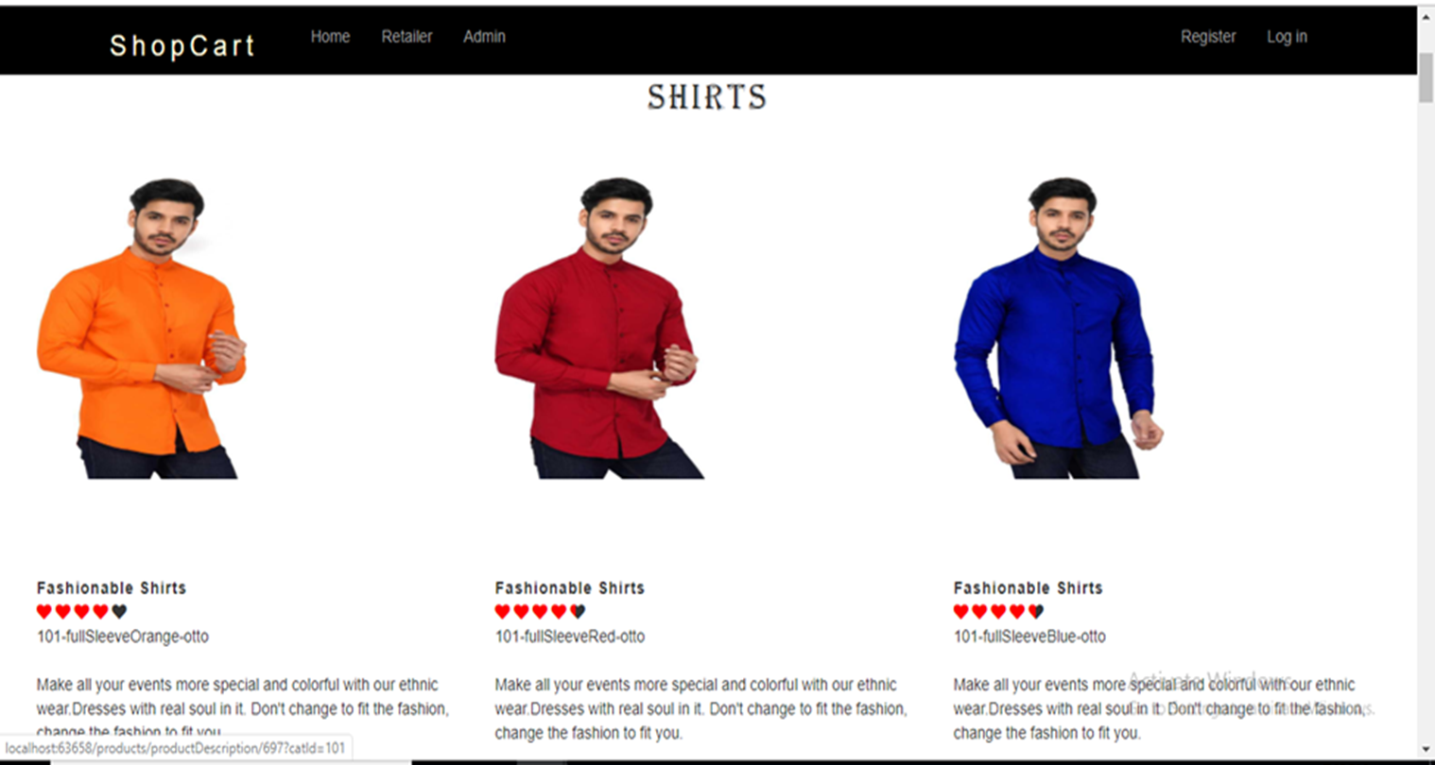
PRODUCTS

Slide 9
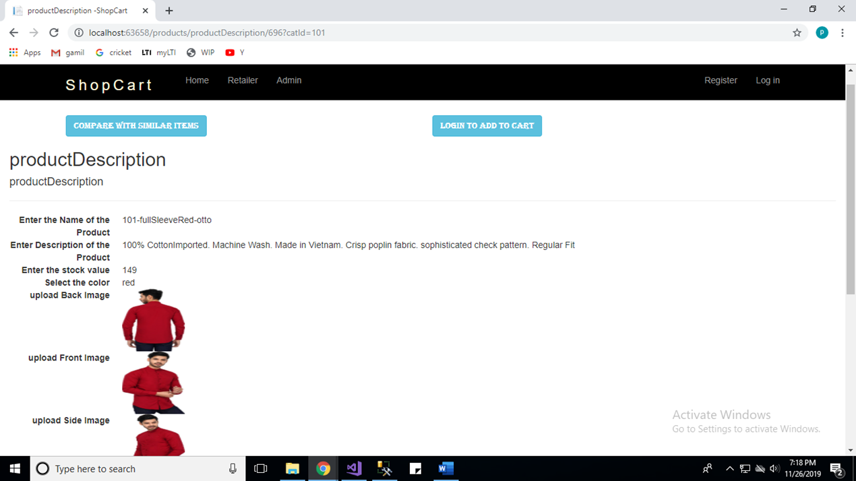
PRODUCT DESCRIPTION

Slide 10
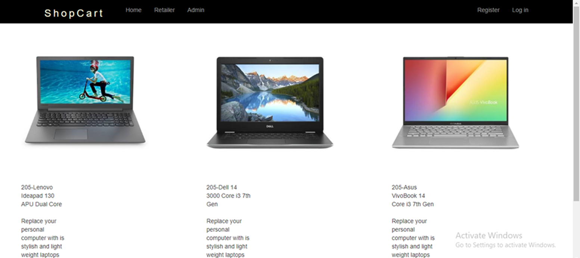
COMPARISION

Slide 11
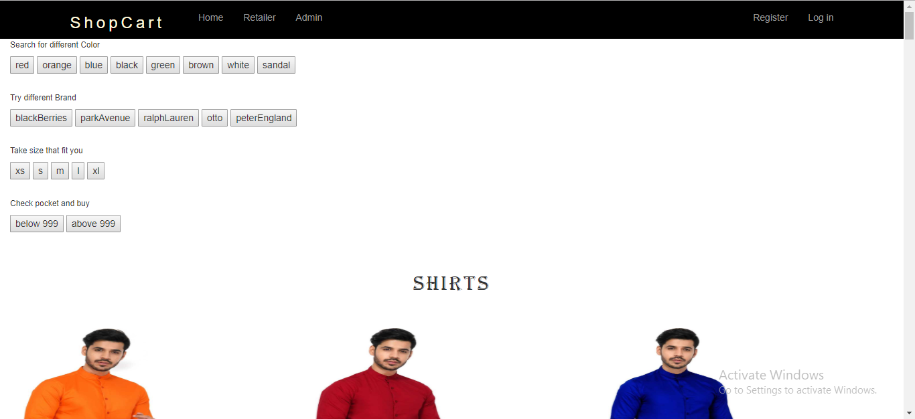
FILTERS

Slide 12
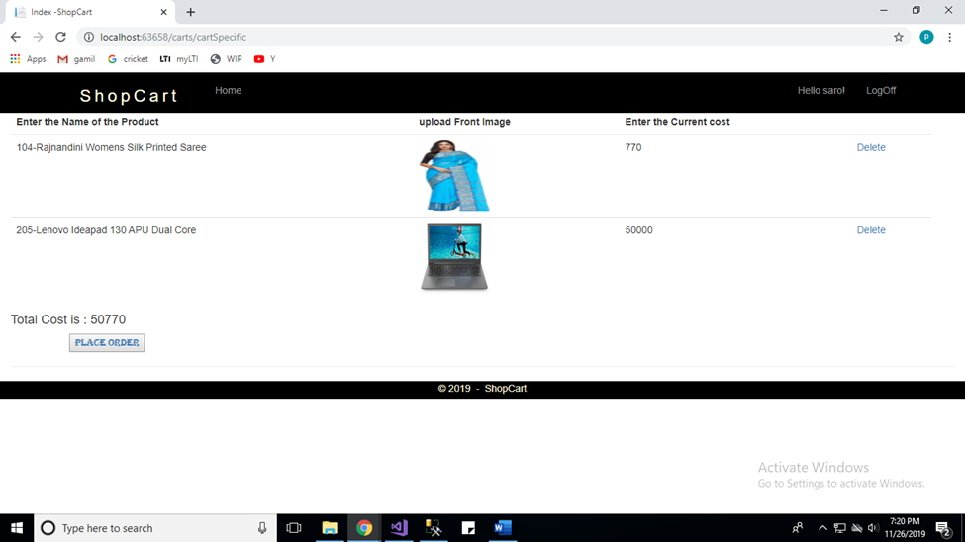
CART

Slide 13
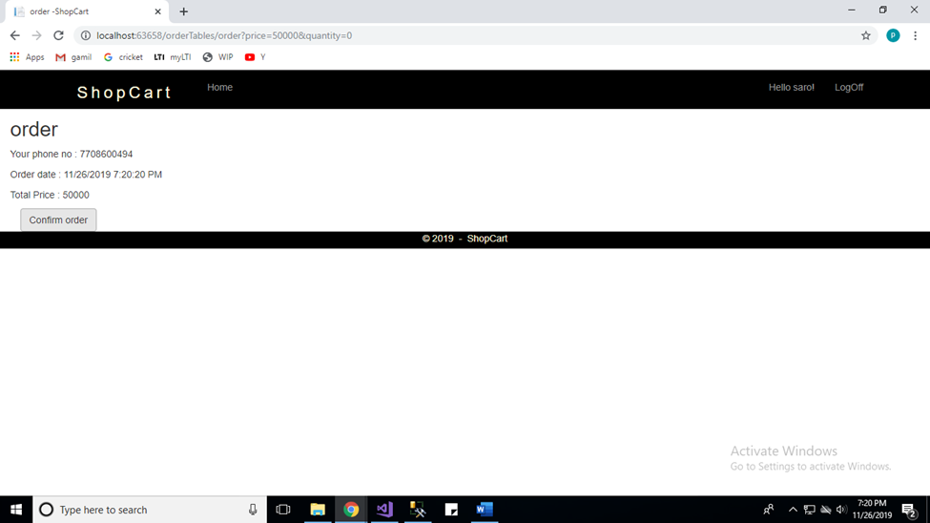
PLACE ORDER

Slide 14
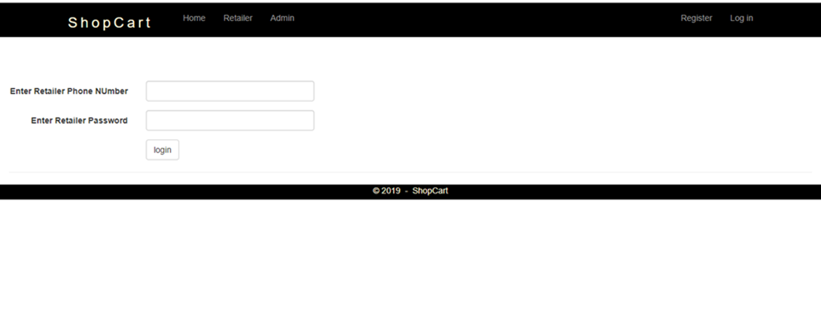
RETAILER

Slide 15
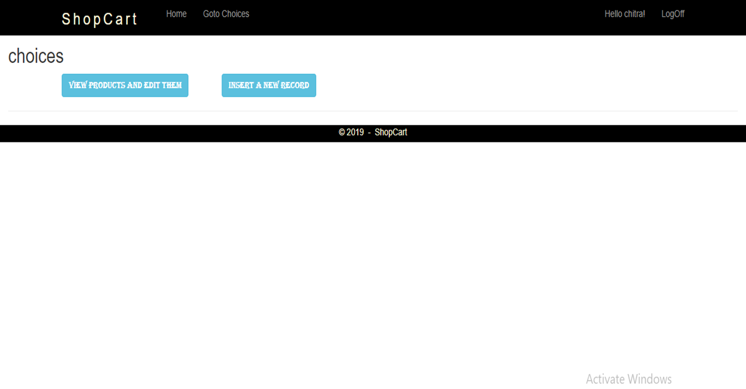

Slide 16
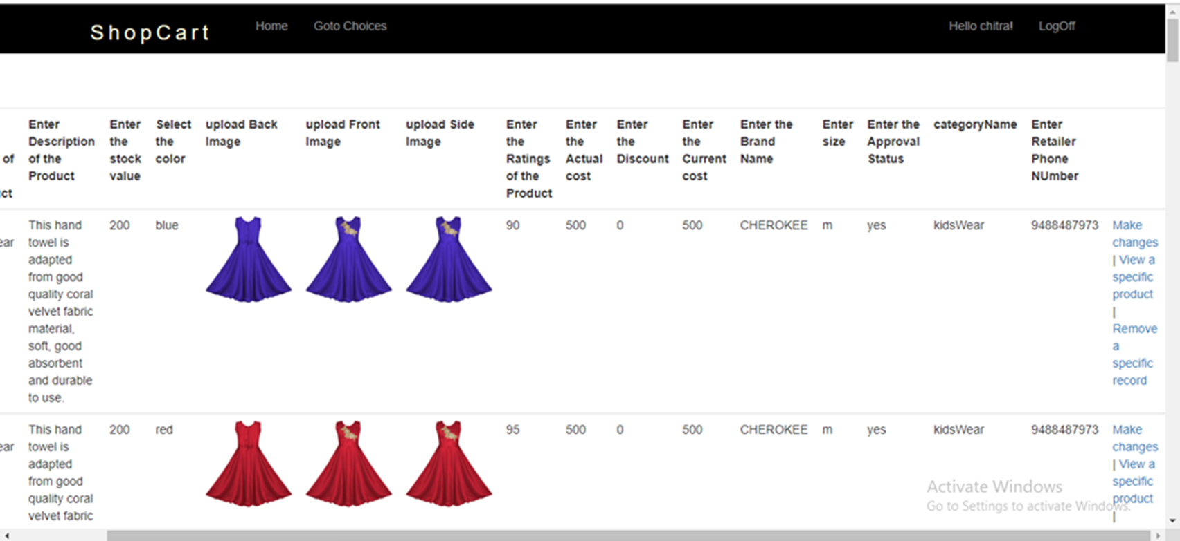

Slide 17
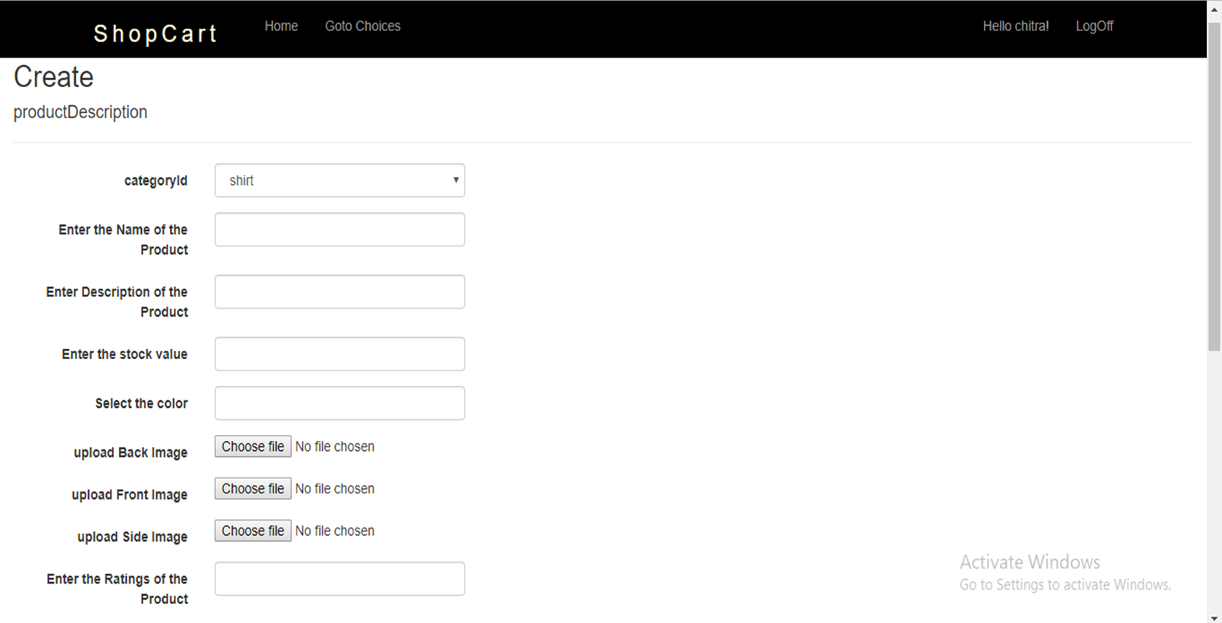

Slide 18
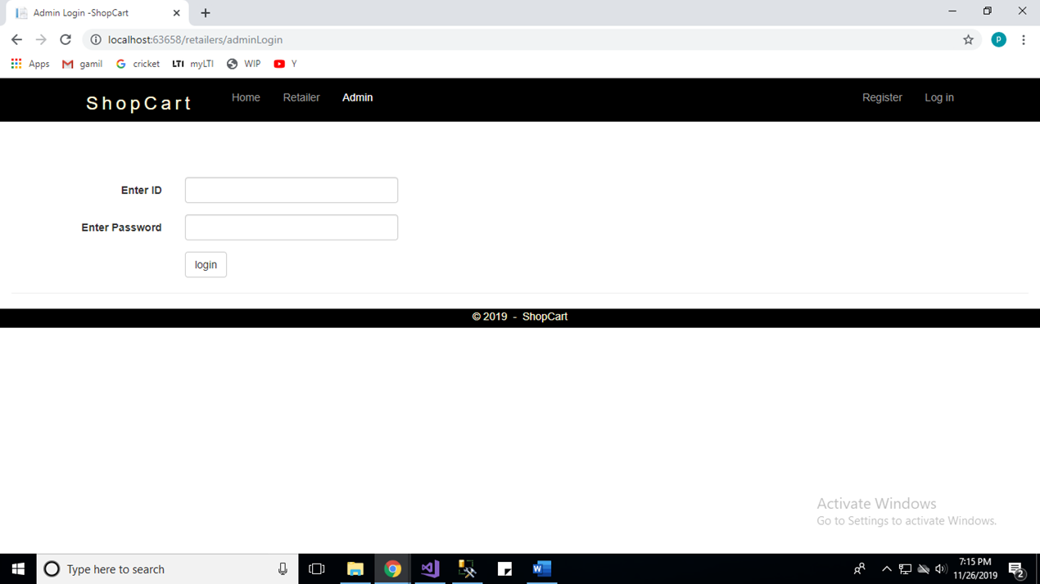
ADMIN

Slide 19
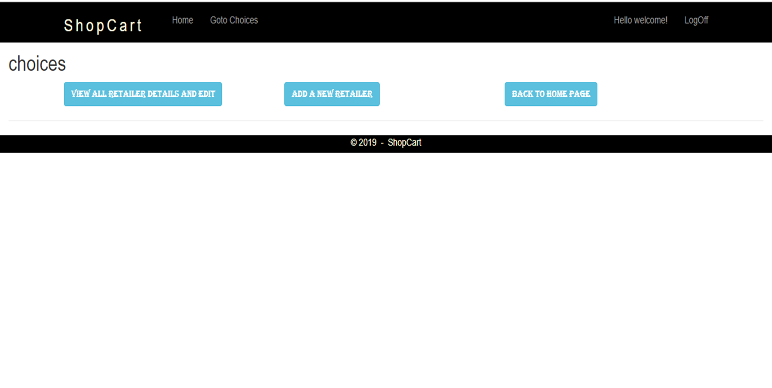

Slide 20
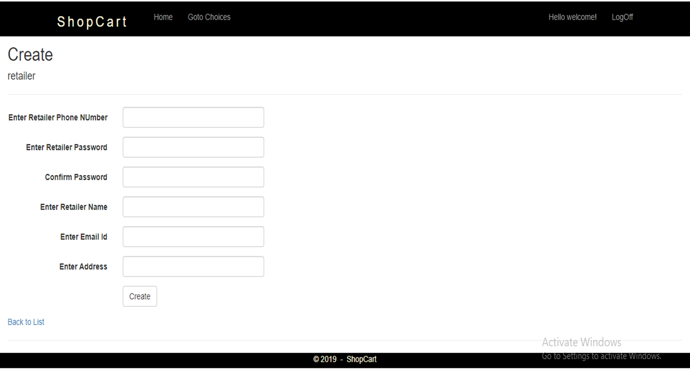

Slide 21
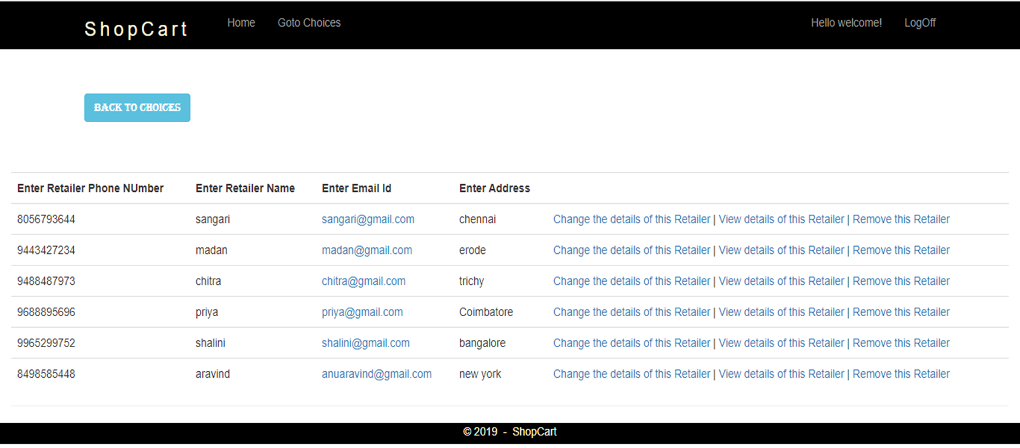

Slide 22
THANK YOU

